Slide 1
Life Expectancy Analysis
Using Python
By Sahil

Slide 2
Introduction
Life expectancy is one of the most important indicators of a country's overall health and development. It represents the average number of years a person is expected to live, based on the prevailing mortality rates at the time of birth. A higher life expectancy typically reflects better healthcare systems, higher living standards, and greater social and economic development, while a lower life expectancy often points to issues such as poverty, limited access to healthcare, malnutrition, or high rates of disease.
Understanding the factors that influence life expectancy is crucial for governments, researchers, and policymakers. It enables them to pinpoint areas that require intervention, allocate resources more effectively, and develop policies aimed at improving public health outcomes. For example, identifying a strong relationship between education levels and life expectancy could motivate investment in schooling, while a strong link between preventable diseases and lower life expectancy could lead to more targeted healthcare initiatives.

Slide 3
Objective:
The primary objective of this analysis is to understand the key factors that influence life expectancy across different countries and regions. From year 2000 to 2015 By analyzing historical health, economic, and social data, this study aims to uncover patterns, relationships, and disparities that contribute to variations in life expectancy worldwide.
Specifically, the objectives are to:
Identify the major health, economic, and social indicators that are most strongly correlated with life expectancy.
Examine regional and continental differences in life expectancy and explore potential reasons behind these variations.
Analyze trends over time to understand how life expectancy has changed globally and what factors have driven these changes.
Evaluate the impact of preventable diseases (such as HIV/AIDS, Polio, and Diphtheria) on life expectancy in different parts of the world.
Explore the role of education, income, and healthcare access in influencing life outcomes and longevity.
Provide actionable insights that can help guide policy decisions, public health initiatives, and global development strategies.
By achieving these objectives, this analysis aims to contribute to a better understanding of global health challenges and support data-driven solutions to improve life expectancy for all.

Slide 4
Data Preprocessing Steps:
1. Loading and Reading Data.
2.Data Shape.
3.Drop Duplicate Rows and Columns.
4. Dataset Overview.
5.Handling Null Values
6.Checking Datatypes.
7.Statistical Summary (Using describe())
8.Quick Summary of Dataset(Using Info())

Slide 5
Columns Overview
Column Name | Description
Country | Name of the country
Year | Year of observation
Status | Development status: Developed or Developing
Life expectancy | Average life expectancy (in years)
Adult Mortality | Probability of dying between 15 and 60 years per 1000 population
infant deaths | Number of infant deaths per 1000 live births
Alcohol | Alcohol consumption (liters per capita, age 15+)
percentage expenditure | Expenditure on health as % of GDP
Hepatitis B | % of 1-year-olds immunized against Hepatitis B
Measles | Measles cases per 1000 population
BMI | Average Body Mass Index
under-five deaths | Deaths of children under 5 per 1000 live births

Slide 6
Columns Overview
Column Name | Description
Polio | % of 1-year-olds immunized against Polio
Total expenditure | Total health expenditure as % of government budget
Diphtheria | % of 1-year-olds immunized against Diphtheria
HIV/AIDS | Deaths per 1000 due to HIV/AIDS
GDP | Gross Domestic Product in USD
Population | Population of the country
thinness 1-19 years | % of children/adolescents aged 1–19 who are underweight
thinness 5-9 years | % of children aged 5–9 who are underweight
Income composition of resources | Index reflecting income component of Human Development Index
Schooling | Average number of years of schooling
Continent | Continent the country belongs to (manually added)

Slide 7
Exploratory Data Analysis
By SAHIL

Slide 8
1.Correlation of life expectancy with other columns
Rank | Feature | Correlation with Life Expectancy | Impact
1 | Schooling | 0.747 | Strong Positive
2 | Income composition of resources | 0.725 | Strong Positive
Insight:
Life Expectancy is heavily correlated by the schooling and income composition of resources.
As the Schooling and Income Composition of Resources increases life expectancy also increases over the years

Slide 9
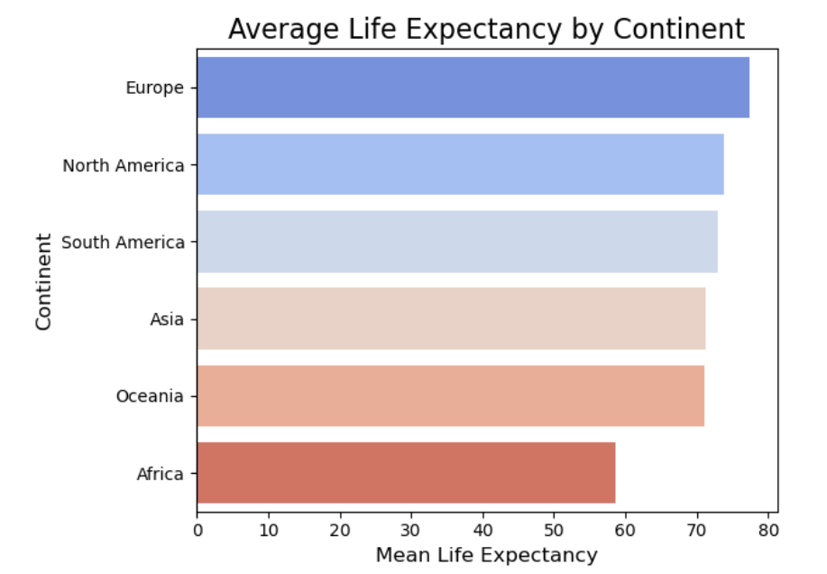
2.Life Expectancy By Continents
Insight:
From Year 2000 to 2015 Europe has the highest mean life expectancy
and Africa has the lowest life expectancy

Slide 10
Key Insights:
 | Insight
1 | Japan has the highest average life expectancy at 82.54 years, followed by Sweden and Iceland.
2 | Sierra Leone has the lowest average life expectancy at 46.11 years, followed by Central African Republic and Lesotho.
3 | The lowest life expectancy ever recorded in the dataset is 36.3 years, observed in Haiti in 2010.
4 | Haiti experienced the highest drop in life expectancy, with a significant decline of 28.7% over the years.

Slide 11
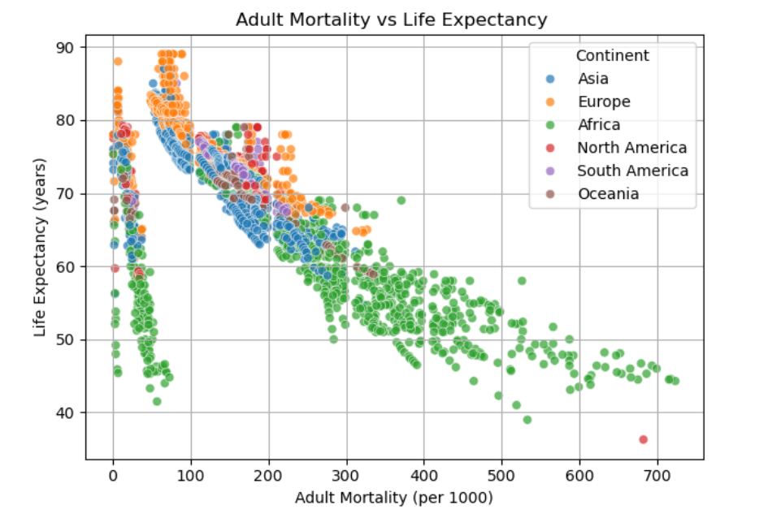
3.Adult Mortality:
Insight:
Adult Mortality refers to the probability of dying between the ages of 15 and 60 years, typically expressed per 1,000 adults in the population.
Adult Mortality Rate=( No of Death between age 15 to 60) / (Total Population between age 15 to 60) * 1000
1.There is a negative relationship between adult mortality and life expectancy — as adult mortality increases, life expectancy decreases.
2.The African continent has the highest adult mortality rates, which is why many countries in Africa tend to have lower life expectancy.
3.In contrast, countries from other continents generally have lower adult mortality and therefore enjoy a higher life expectancy.

Slide 12
Key Insights:
1 | Zimbabwe recorded the highest adult mortality rate of 723 in the year 2004 — the highest ever in the dataset.
2 | Lesotho has the highest average adult mortality rate at 550, followed by Zimbabwe (462) and Botswana (462.37) over the years.
3 | By continent, Africa has the highest average adult mortality rate at 266, while Europe has the lowest at 98.
4 | In 2015, the countries with the highest adult mortality rates were Zimbabwe, Botswana, Haiti, Lesotho, and Malawi.
5 | Top 5 countries where adult mortality increased in 2015 vs. previous year: Cote d'Ivoire, Uganda, Tanzania, Comoros, and Rwanda.
6 | Top 5 countries where adult mortality decreased in 2015 vs. previous year: Zambia, Burkina Faso, Haiti, Madagascar, and Niger.

Slide 13
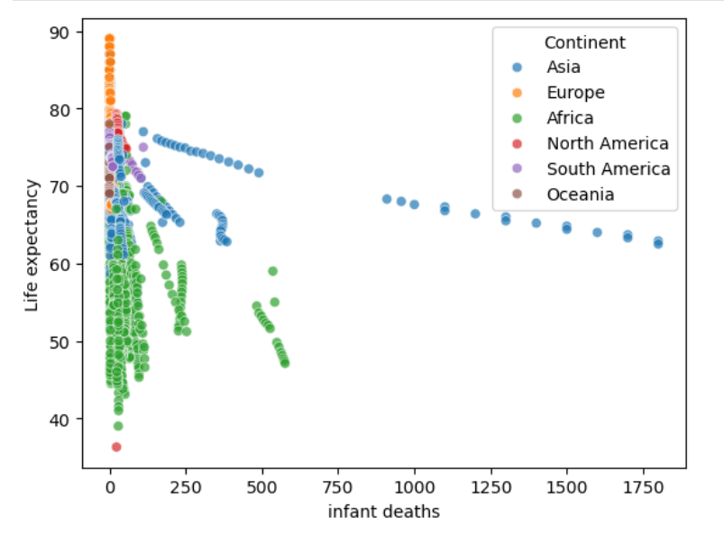
4.Infant Deaths:
Insight:
Infant deaths refers to the number of children who die before reaching 1 year of age, usually measured per year per country.
There is a clear negative relationship between infant deaths and life expectancy — as the number of infant deaths increases, life expectancy decreases.
This trend is most noticeable in African and Asian countries, where infant death rates have remained relatively high over the years. As a result, these regions often experience lower life expectancy compared to other parts of the world

Slide 14
Key Insights
# | Insight
1 | Asia has the highest number of total infant deaths (45,778), followed by Africa (38,229) and South America (2,206).
2 | Oceania has the lowest number of total infant deaths among all continents.
3 | The countries with the highest total infant deaths are: India (21,867), Nigeria (8,571), and Pakistan (5,887).
4 | In the year 2015, the countries with the highest infant deaths were: India (910), Nigeria (483), and Pakistan (352).
5 | There were a total of 59 countries with 0 infant deaths recorded in 2015.
6 | Among those, Europe had the highest count with 27 countries, followed by Asia (9), North America (8), Oceania (8), Africa (4), and South America (3).

Slide 15
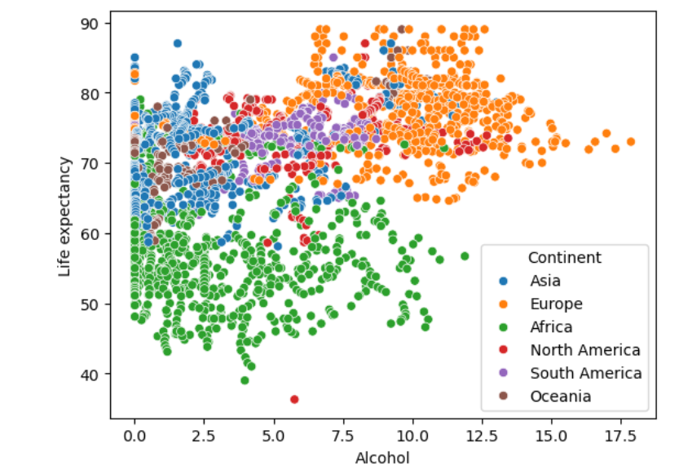
5.Alcohol
Insight:
Alcohol = Per capita alcohol consumption (in litres of pure alcohol) per year.
1.Alcohol consumption is not strongly correlated with life expectancy. In fact, the relationship appears to be weak or inconsistent across different regions.
2.There are several European countries where alcohol consumption is relatively high, yet life expectancy is also high — suggesting that high alcohol intake does not necessarily lead to lower life expectancy in those regions.
3.On the other hand, many African countries have very low levels of alcohol consumption, but still suffer from low life expectancy. This indicates that other factors, such as healthcare access, disease burden, or economic conditions, play a much more significant role in influencing life expectancy than alcohol alone.

Slide 16
Key Insight:
Category | Details
Highest Avg. Alcohol Consumption by Continent | Europe — 9.4 liters per person per year (on average)
Top 5 Countries by Avg. Alcohol Consumption (All Years) | 1. Belarus (13.5) 2. Czechia (13.0) 3. Lithuania (12.7) 4. Ireland (12.5) 5. Croatia (12.4) All from Europe
Top 5 Countries by Highest Alcohol Consumption in a Single Year | 1. Estonia (17.87) 2. Belarus (17.31) 3. Lithuania (15.19) 4. Ireland (14.27) 5. Portugal (14.21)
Top 5 Countries by Alcohol Consumption in 2015 | 1. Lithuania (15.29) 2. Belarus (13.94) 3. Czechia (12.68) 4. Belgium (12.60) 5. Austria (12.32)
Countries with Notable alcohol Increase in 2015 vs 2014 | - UK: +0.29 - Albania: +0.09
Countries with Highest Decrease in 2015 vs 2014 | - New Zealand: −0.37 - Norway: −0.09 - Singapore: −0.04

Slide 17
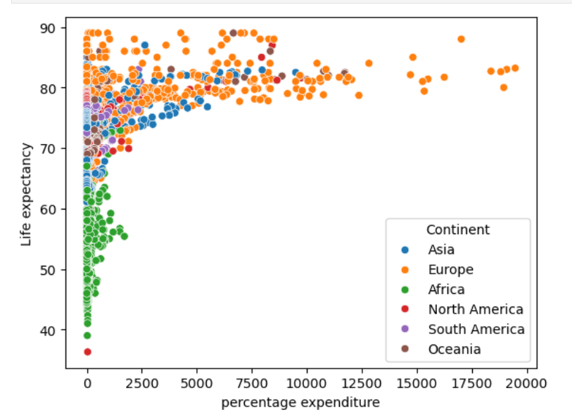
6. Percentage Expenditure:
Insight:
percentage expenditure = Total expenditure on health as a percentage of GDP.
As percentage expenditure on health increases, life expectancy also tends to increase.
European countries generally have higher health expenditure percentages, which contributes to their higher life expectancy.
On the other hand, African countries show lower health expenditure, which correlates with lower life expectancy over the years.

Slide 18
Key Insights:
Insight | Details
Continent with Highest Avg. % Expenditure | Europe has the highest average percentage expenditure on health over the years.
Continent with Lowest Avg. % Expenditure | Africa has the lowest average percentage expenditure on health over the years.
Country with Highest Mean % Expenditure | Switzerland (Europe) has the highest mean percentage expenditure: 9801.
Highest % Expenditure in a Single Year (All Years) | Switzerland again leads with the highest recorded value of 19479 in a single year.
Country with Highest % Expenditure in 2015 | Albania (Europe) had the highest health percentage expenditure in 2015: 364.97.

Slide 19
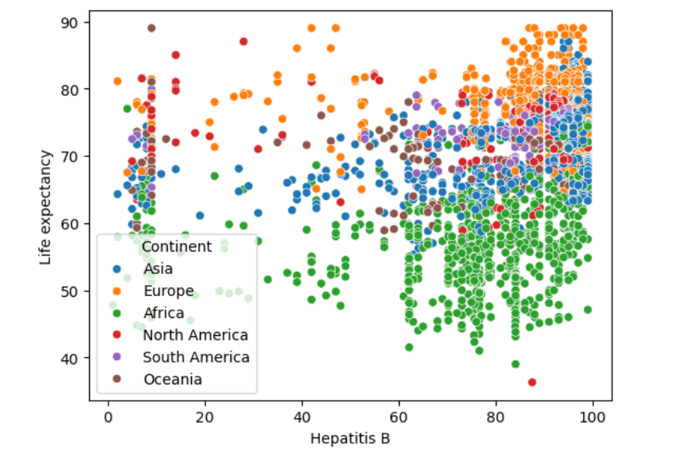
7.Hepatitis B:
Insight:
Hepatitis B is a viral infection that affects the liver and can cause both acute and chronic disease
As Hepatitis B vaccination coverage increases over the years, there is a noticeable rise in life expectancy across various continents.
This suggests a positive relationship between immunization and overall health outcomes.
However, life expectancy tends to be significantly higher in European ,Asian,
North American, South American and oceania countries as compared to other African countries indicating that these continents not only have better vaccination rates but also more robust healthcare systems and living conditions.

Slide 20
Key Insights:
Category | Details
Continent with Highest Avg. Hepatitis B | Europe — Average vaccination rate is 84.84%, meaning ~85 children are vaccinated yearly.
Top 3 Countries with Highest Avg. Rate | Monaco (99%), Niue (99%), Palau (99%) — Highest consistent vaccination over the years.
Lowest Recorded Hepatitis B Rate | Côte d'Ivoire (1.0%) in 2001 — the lowest ever recorded in the dataset.
Lowest in Recent Year (2015) | Haiti (6%) and Philippines (6%) — extremely low coverage in the most recent year.

Slide 21
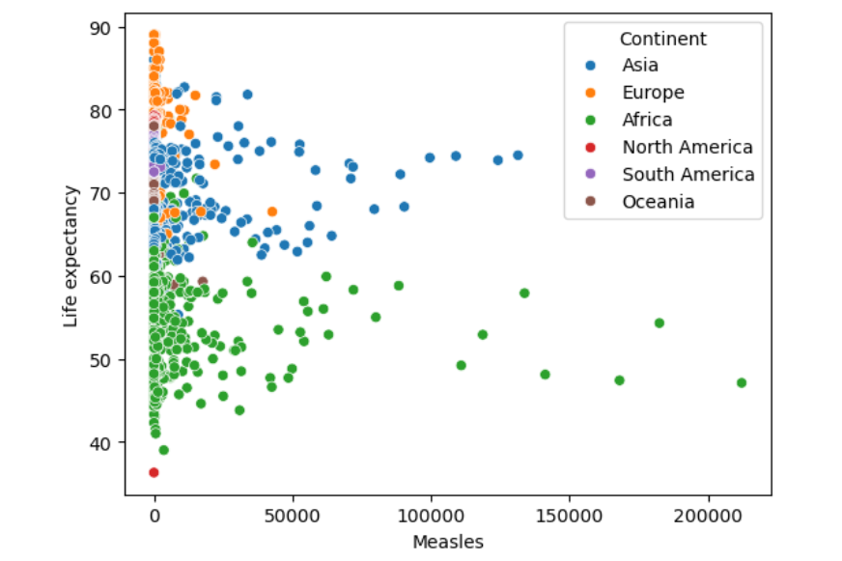
8 Measles:
Insight:
As the number of measles cases increases, life expectancy tends to decrease.
This negative relationship is especially evident in African and Asian countries, where a higher incidence of measles over the years has contributed to lower life expectancy.
In contrast, countries with better vaccination coverage and fewer measles cases, often in Europe and Oceania, tend to maintain higher life expectancy levels.

Slide 22
Key Insights:
Category | Insight / Description
Continent with Highest Cases | Africa has the highest total number of measles cases: 3,544,150
Next Highest Continents | Asia: 3,202,776, Europe: 309,073, Oceania: 42,067, North America: 5,869
Continent with Lowest Cases | South America has the lowest total measles cases: 4,287
Top 5 Countries (Overall Cases) | 1. China (1,053,727), 2. Nigeria (826,463), 3. DR Congo (782,763),4. India (743,267), 5. Indonesia (259,919)
Country with Most Cases in 2015 | India reported the highest number of measles cases in 2015: 90,387
Other Top Countries in 2015 | China and Mongolia

Slide 23
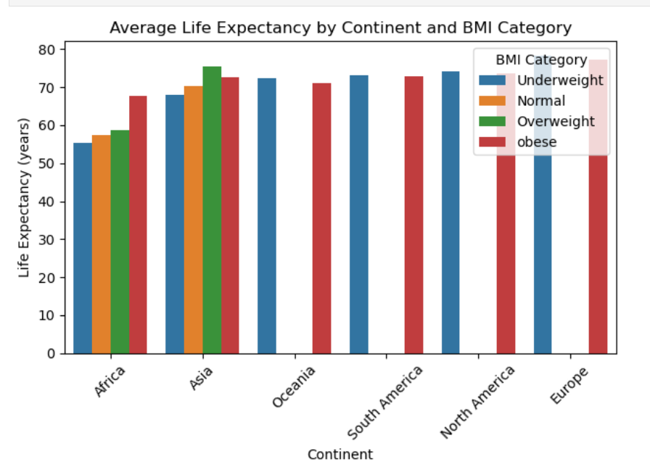
9.BMI
Insight
BMI (Body Mass Index) is a numerical measure used to determine whether a person has a healthy weight for their height. It helps assess whether someone is underweight, normal weight, overweight, or obese.
When analyzing life expectancy by BMI category and continent:
European countries that fall under the underweight BMI category have the highest average life expectancy, at approximately 78.17 years.
In contrast, African countries within the same underweight BMI category have the lowest average life expectancy, around 55.46 years.

Slide 24
Key Insight:
Category | Country | Continent | Life Expectancy (Years) | Description
Most Obese Country (Overall) | Nauru | Oceania | 69.0 | Nauru has the highest average BMI over the years, indicating high obesity levels.
Most Underweight Country (Overall) | Vietnam | Asia | 73.8 | Vietnam records the lowest average BMI over the years, indicating underweight population.
Most Obese Country in 2015 | Kiribati | Oceania | 66.3 | In the year 2015, Kiribati had the highest BMI among all countries.
Most Underweight Country in 2015 | Madagascar | Africa | 65.5 | Madagascar had the lowest BMI in 2015, placing it in the underweight category.

Slide 25
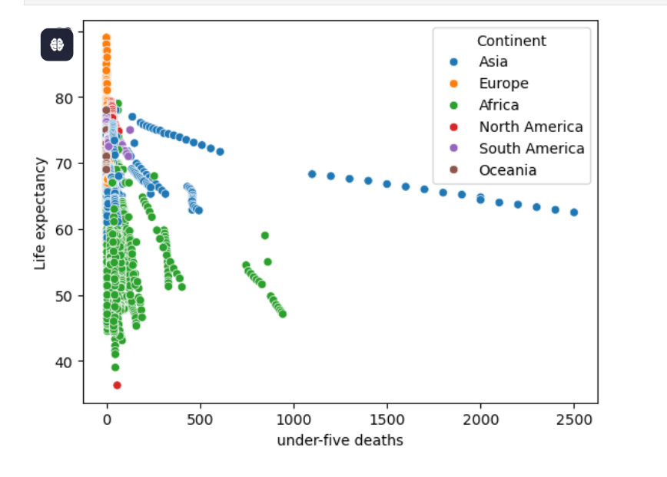
10.Under 5 Deaths.
Insight:
The number of children who died before reaching the age of five in a given country and year.
Under-five deaths are predominantly high in African and Asian countries. This elevated mortality rate among young children significantly contributes to lower life expectancy in these regions.
In contrast, European, North American, South American, and Oceania countries experience very low under-five death rates, which helps maintain a higher life expectancy over the years.

Slide 26
Key Insight
Category | Details / Values
Continent with Highest Under-5 Deaths (All Years) | Asia (58,902)
Second Highest Continent | Africa (58,576)
Other Continents (Under-5 Deaths Over Years) | South America: 2,580
Continent with Lowest Under-5 Deaths | Oceania (242)
Top Country with Highest Under-5 Deaths (All Years) | India — Consistently the highest under-5 deaths across all years
2nd and 3rd Highest Countries (All Years) | Nigeria, Pakistan
Top 3 Countries with Highest Under-5 Deaths in 2015 | 1. India – 1100 deaths2. Nigeria – 747 deaths3. Pakistan – 433 deaths

Slide 27
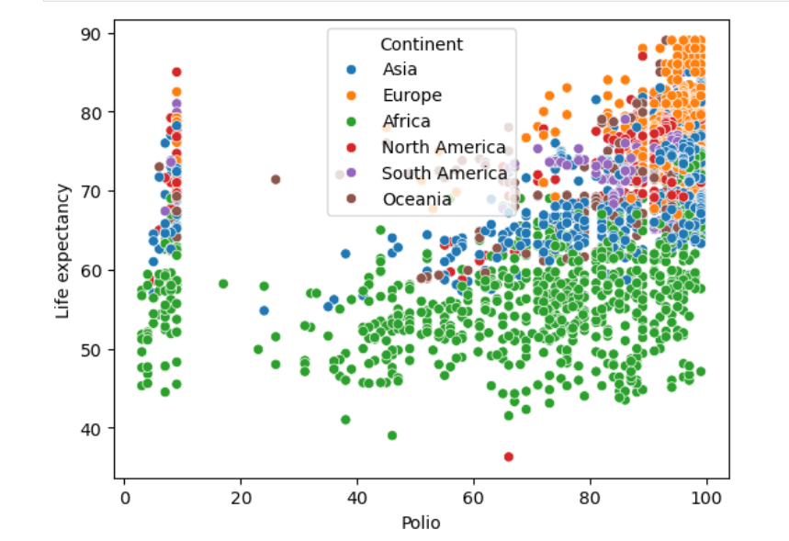
11.Polio
It typically represents the percentage of children aged 1 year who have received at least one dose of polio vaccine in a country for a given year.
The scatter plot shows a relationship between Polio cases and Life Expectancy across continents:
Africa has low Life Expectancy with high Polio cases.
Europe & North America show high Life Expectancy with low Polio cases, indicating strong healthcare systems.
Asia & South America display mixed patterns.
Oceania has low Polio cases and high Life Expectancy.
Insight: Regions with better vaccination and healthcare (like Europe, North America) tend to have higher Life Expectancy and fewer Polio cases, while underdeveloped regions face the opposite trend.

Slide 28
KEY Insights:
Aspect | Details / Description
Continental Vaccination Coverage (Avg) | Europe leads with 93%, followed by Asia (85%), North America, South America, Oceania, and Africa (71%).
Top 5 Countries (Avg. Vaccination %) | Palau, Niue, Monaco, Hungary, Cuba – All maintained ~99% average Polio vaccination over the years.
Lowest Vaccination (Starting Year) | Angola and Chad had the lowest Polio vaccination in early 2000s – only 3% of children vaccinated.
Countries with 100% Vaccination in 2000 | 16 countries, including Belarus, Brazil, Hungary, Oman, Panama, Romania, had 100% coverage in 2000.
Lowest Vaccinated Countries (Year 2015) | Syria (5%), Afghanistan (6%), Angola (7%), Indonesia (8%), Kiribati (8%) had the lowest Polio vaccination in 2015.
Countries with 100% Vaccination (2015) | 31 countries achieved 100% Polio vaccination in 2015.

Slide 29
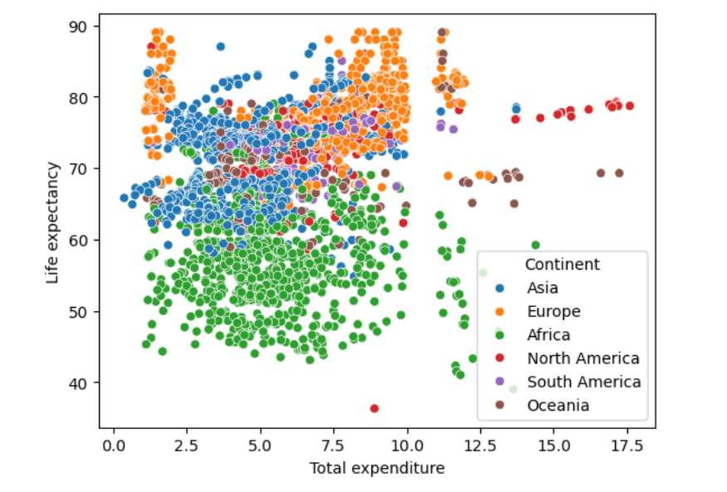
12. Total Expenditure
The total health expenditure expressed as a percentage of a country's Gross Domestic Product (GDP).
This plot shows the link between total spending and life expectancy across continents.
Europe & North America: High spending, high life expectancy.
Africa: Low spending, low life expectancy.
Asia: Mixed trends.
South America & Oceania: Moderate to high spending, good outcomes.
Overall, more spending usually means longer life—but how money is used also matters. Some countries spend more but still struggle, especially in Africa.

Slide 30
Key Insights
Insight | Description
Highest Avg. Total Expenditure | Europe has the highest average total expenditure (7.2% of GDP).
Lowest Avg. Total Expenditure | Asia has the lowest average total expenditure (4.78% of GDP).
Highest Total Expenditure (Cumulative) | Africa spent the most overall on health over the years, followed by Europe, Asia, North America, South America, and Oceania.
Top Countries by Total Expenditure (All Years) | USA ranks first (255.09 total), followed by Micronesia, Sweden, Sierra Leone, and Norway.
Year 2011 Highest | USA had the highest spending in 2011 at 17.60% of GDP.
Year 2007 Lowest | Timor-Leste had the lowest spending in 2007 at just 0.37% of GDP.
Year 2015 Highest | USA again led in 2015 with 17.14%.
Year 2015 Lowest | Kiribati had the lowest in 2015 with only 1.21%.

Slide 31
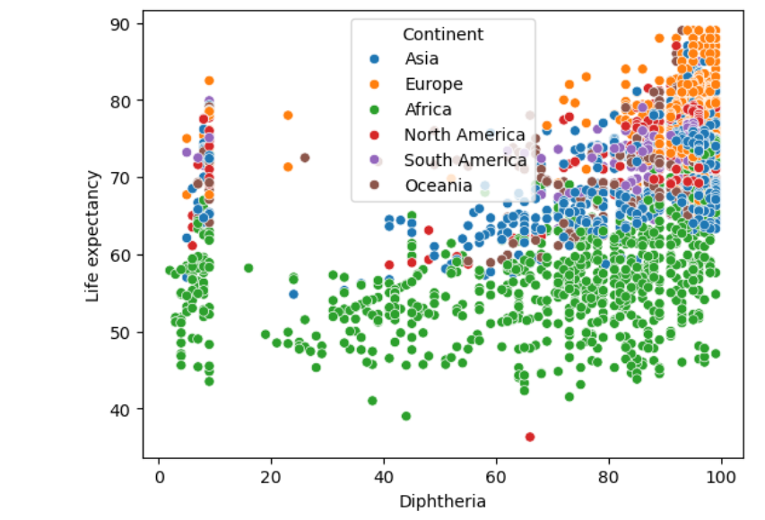
13.Diptheria
Percentage of 1-year-old children immunized against diphtheria in each country per year.
This scatter plot shows how Diphtheria cases relate to Life Expectancy, with differences across continents.
Europe and North America have low Diphtheria cases and high Life Expectancy due to strong vaccination programs.
Africa has more Diphtheria and shorter lifespans, showing healthcare challenges.
Asia shows mixed results, depending on each country's healthcare system.
South America and Oceania generally have moderate to high Life Expectancy with low Diphtheria cases.
Key Insight:
Countries with fewer Diphtheria cases tend to have longer lives, proving the importance of vaccination and disease prevention.

Slide 32
Key Insights
Insight | Description
Highest Avg. Diphtheria Rate (Continent) | Europe leads with an average rate of 92.78%, showing strong vaccination coverage.
Lowest Avg. Diphtheria Rate (Continent) | Africa has the lowest average of 70%, reflecting gaps in immunization.
Top Countries by Avg. Vaccination Rate | Hungary, Palau, Monaco, Niue have the highest average rate (99%) over the years.
Lowest Avg. Diphtheria Rate (Country) | Tuvalu has the lowest average vaccination rate (9%) over the years.
Lowest in Specific Year (2014) | Equatorial Guinea had just 2% vaccination in 2014, the lowest recorded that year.
Top Performers in 2015 | 27 countries achieved the highest Diphtheria vaccination rate (likely ~99–100%) in 2015.
Lowest in 2015 | Haiti and Philippines had the lowest Diphtheria rate (6%) in 2015.

Slide 33
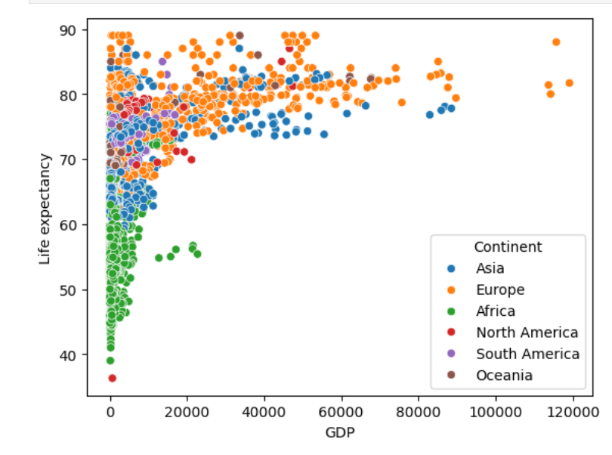
14.GDP
GDP (Gross Domestic Product) is the total amount of money a country earns from everything it produces and sells in a year — like goods, services, and business.
It shows how rich or poor a country is and how strong its economy is.
This plot shows how GDP relates to Life Expectancy across continents.
Europe & Oceania: High GDP, long life.
Africa: Low GDP, shorter life.
Asia: Mixed—some rich and healthy, others less so.
North America: Mostly high GDP and life expectancy.
South America: Moderate GDP, mixed outcomes.
Trend:
Higher GDP usually means longer life, due to better healthcare and living conditions.
Some rich countries don’t live longer—how money is used matters.
Wealth helps, but smart spending improves health most.

Slide 34
KEY INSIGHTS:
Insight | Description
Highest Average GDP (Continent) | Europe has the highest average GDP at 17,447.57, showing strong economies.
Lowest Average GDP (Continent) | Africa has the lowest average GDP at 1,554.45, reflecting economic struggles.
Highest Total GDP (Continent) | Europe has the highest total GDP over the years.
Lowest Total GDP (Continent) | South America has the lowest total GDP overall.
Top Countries by Total GDP (All Years) | Switzerland ranks first, followed by Luxembourg, Qatar, Netherlands, and Australia.
Lowest GDP (All Years) | Nauru has the lowest total GDP (136.18), followed by Dominica (722) and Palau (1,932).
Top GDP in 2015 | Qatar had the highest GDP in 2015, followed by Australia, Singapore, Netherlands, and Austria.
Lowest GDP in 2015 | Burundi had the lowest GDP (33.68), followed by Madagascar (41) and Azerbaijan (55).

Slide 35
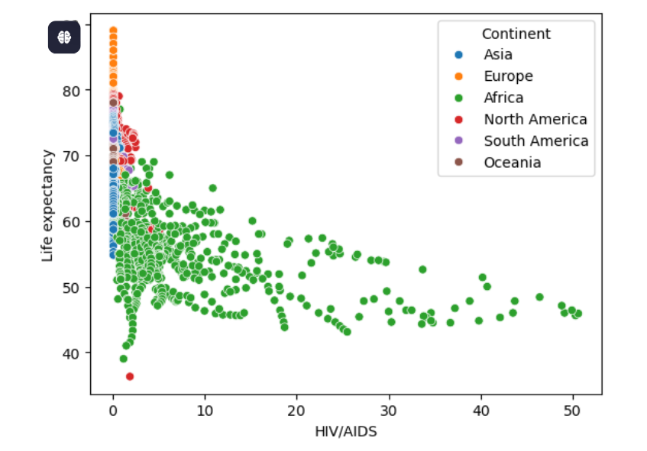
15. HIV/Aids
Number of deaths caused by HIV/AIDS per 1,000 people in a country for a specific year.
This scatter plot shows how HIV/AIDS prevalence affects Life Expectancy across continents.
1 Main Trend:
Higher HIV/AIDS rates = Lower Life Expectancy.
Countries with very high HIV cases often have life expectancy below 50 years.
2 Regional Patterns:
Africa has the highest HIV/AIDS rates and lowest life expectancy.
Europe & North America have low HIV rates and high life expectancy, thanks to strong healthcare.
Asia & Oceania show low HIV prevalence and better life outcomes.
South America has moderate HIV rates and mixed life expectancy.
3. Takeaway:
HIV/AIDS greatly reduces life expectancy, especially in Africa.

Slide 36
Key Insights
Insight | Description
Continent with Highest Average HIV/AIDS Rate | Africa has the highest average HIV/AIDS rate over the years at 5.4%, showing a major ongoing health concern.
Continent with Lowest Average HIV/AIDS Rate | Europe has the lowest average HIV/AIDS rate at just 0.11%, reflecting strong disease control and prevention programs.
Country with Highest Average HIV/AIDS Rate | Swaziland (now Eswatini) had the highest average HIV/AIDS prevalence over the years at 32%.
Other High Average Countries | Zimbabwe and Lesotho follow with high average HIV/AIDS rates of 23% and 22% respectively.
Swaziland's Highest Recorded Annual Rates | Swaziland recorded the highest individual yearly HIV/AIDS rates: 2002: 49.9% 2003: 50.06% 2004: 50.03%
| Top 3 Countries by HIV/AIDS in 2015
Swaziland: 50.6%
Zimbabwe: 43.5%
Botswana: 38.8%
These countries had the most severe HIV/AIDS cases that year. |

Slide 37
16.Income Composition of Resources
Income composition of resources represent a composite index score between 0 and 1.
It measures the access to and quality of resources that contribute to a decent standard of living in a country.
Higher values (close to 1) mean people have better income, education, and standard of living.
Lower values (closer to 0) mean there is less access to these resources.

Slide 38
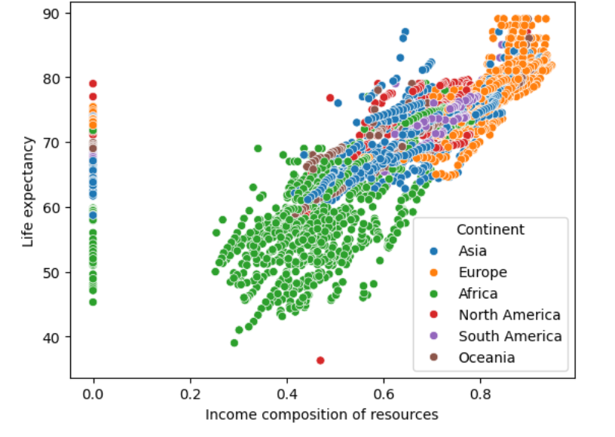
16.1 Income Composition of Resources vs Life Expectancy
This scatter plot shows how a country’s income composition relates to life expectancy across continents.
Main Trend:
Higher income resources = Longer life.
Countries with low income levels often have life expectancy below 60 years.
Regional Patterns:
Africa: Low income and low life expectancy.
Europe & North America: High income and long life.
Asia: Mixed income levels and life expectancy.
South America & Oceania: Moderate to high income, with good life expectancy.
Takeaway:
Better income and resources lead to healthier, longer lives. Economic growth and investment in social services can improve health outcomes globally.

Slide 39
Other key insight
Insight | Details
Top Continent | Europe – Highest average income composition (0.80).
Lowest Continent | Africa – Lowest average, showing economic challenges.
Top Countries (Avg, All Years) | Norway (0.93), Australia (0.918), Switzerland (0.911).
Lowest Countries (Avg, All Years) | South Sudan (0.13), Bhutan (0.18), Turkmenistan (0.20).
Top Countries (2015) | Norway (0.94), Switzerland (0.93), Australia (0.93).
Lowest Countries (2015) | Central African Rep. (0.34), Niger (0.35), Chad (0.39).

Slide 40
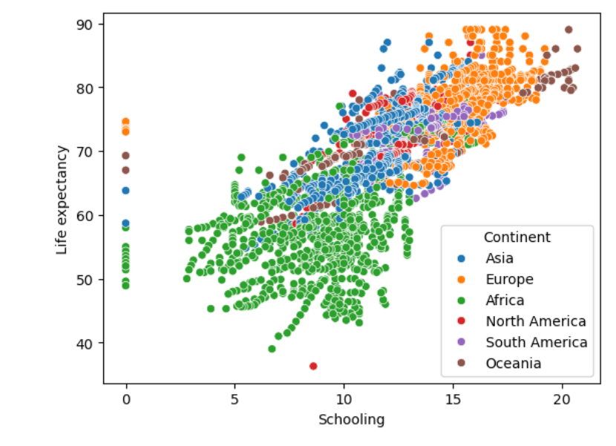
17 . Schooling
Schooling shows how many years of education (like primary, secondary, and possibly college) people typically get in a country.
The scatter plot shows a positive relationship between schooling and life expectancy across continents.
Higher schooling levels generally correspond to longer life spans.
Europe and Asia lead in life expectancy at similar education levels, while
Africa shows lower and more varied outcomes.
North America and Oceania maintain consistently high life expectancy, whereas South America falls in a moderate range.
Overall, education is a strong global predictor of life expectancy, though regional disparities exist.

Slide 41
Other Key Insight
Insight | Description
Continent with Highest Avg. Schooling | Europe – Highest average schooling: 15.2 years.
Continent with Lowest Avg. Schooling | Africa – Lowest average schooling: 9.2 years.
Top Countries (Avg, All Years) | Australia (20 yrs), New Zealand (18.86 yrs), Iceland (18.1 yrs) – Leading in long-term education.
Countries with No Schooling Data | Marshall Islands and Tuvalu – No reported schooling years.
Lowest Avg. Schooling (All Years) | South Sudan (1.53 yrs), Niger (4 yrs), Djibouti (4.7 yrs) – Very limited access to education.
Top 5 Countries (2015) | Australia (20.4 yrs), New Zealand (19.2), Denmark (19.2), Iceland (19.0), Ireland (18.6).
Bottom 5 Countries (2015) | South Sudan (4.9), Eritrea (5.0), Niger (5.4), Djibouti (6.3), Central African Rep. (7.1).

Slide 42
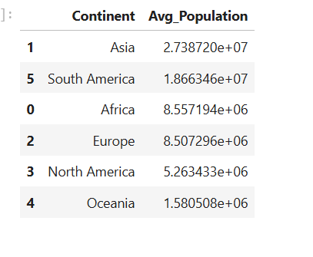
18.Population
Insight
Asia continent has highest population over years followed by South America , Africa , Europe , North America and Oceania

Slide 43
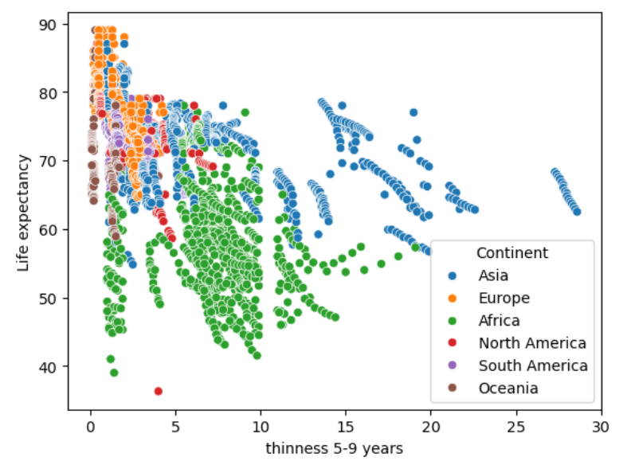
19.Thinness 5 to 9 years
Africa: High child thinness (>10%) and low life expectancy (40–60 yrs) serious undernutrition issues.
Asia: Mixed thinness levels with moderate to high life expectancy.
Europe & North America: Very low thinness (0–5%) and high life expectancy (70+ yrs).
South America: Moderate thinness with strong life expectancy.
Oceania: Very low thinness and high life expectancy.
Overall Insight:
Higher child thinness links to lower life expectancy — showing how child nutrition deeply affects national health and longevity.

Slide 44
Key Insights
Category | Insight | Description
Continents with Highest Avg Thinness | Asia (7.5%), Africa (7.1%) | Children aged 5–9 in these regions show higher undernutrition rates.
Continents with Moderate Thinness | North America, South America | Thinness levels are in the mid-range.
Continents with Lowest Avg Thinness | Europe, Oceania | Better child nutrition, lower thinness rates.
Highest Avg Thinness (Country) | India (28%) | India has the highest long-term average thinness among 5–9-year-olds.
Next Highest Countries | Bhutan (17.9%), Nepal (17.6%) | Also show significant child undernutrition.
Lowest Avg Thinness (Countries) | Palau, Marshall Islands, Tonga, Tuvalu | These countries show almost no thinness issues.
Peak Thinness Recorded | India (28.6%), Pakistan (22.6%), Bangladesh (21.5%) | Years when highest levels were observed.
Top Thinness (5–9 Age Group) | India (27.3%), Pakistan (19.6%), Bangladesh (18.3%) | Highest thinness rates in this specific age group.

Slide 45
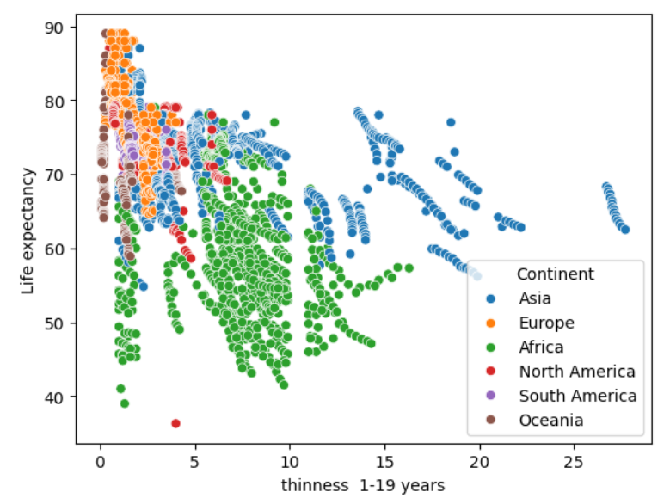
20.Thinness 1 to 19 years
There is a clear inverse relationship between childhood thinness and life expectancy:
Higher thinness (10%+) is linked with lower life expectancy (often below 60 years).
Lower thinness (0–5%) corresponds with higher life expectancy (above 70 years).
By Continent:
Africa: Highest thinness rates and lowest life expectancy.
Asia: Wide range in both thinness and life expectancy.
Europe & North America: Low thinness and high life expectancy.
South America: Moderate thinness, strong life expectancy.
Oceania: Very low thinness, high life expectancy.
Conclusion: Better childhood nutrition strongly supports longer life expectancy.

Slide 46
Key Insights
Insight | Description
Continents with Highest Avg Thinness | Asia (7.3%) and Africa (7.2%) face the greatest challenges with child undernutrition.
Continents with Lowest Avg Thinness | Europe, Oceania, and North America show low thinness rates, reflecting better nutrition and food access.
🇮🇳 Country with Highest Avg Thinness (All Years) | India leads with 27%, followed by Bhutan and Nepal, indicating long-term undernutrition issues.
Countries with Maximum Thinness Ever Recorded | India (27.7%), Pakistan (22.2%), and Afghanistan (19.9%) show the highest historical thinness levels.
Top 3 in Year 2015 | India (26.7%), Pakistan (19.2%), and Bangladesh (17.9%) had the highest thinness in 2015.

Slide 47
Conclusion:
The analysis clearly shows that life expectancy is shaped by a complex mix of social, economic, and health-related factors.
Income composition and education (schooling) are the strongest positive influencers — countries with better living standards and higher education levels consistently report longer life spans.
Health factors such as adult mortality, infant deaths, and HIV/AIDS prevalence have a major negative effect on life expectancy, particularly in developing regions.
Vaccination coverage (Polio, Diphtheria, Hepatitis B) shows a strong positive link with longer life expectancy, emphasizing the role of public health programs.
Higher healthcare expenditure contributes to longevity, but how resources are allocated matters more than the total spending.
Regional differences persist — Europe and North America lead in life expectancy due to strong healthcare systems and education, while Africa faces challenges from disease burden and limited healthcare access.

Slide 48
Recommendations
Prioritize Socioeconomic Development:
Governments should invest in programs that improve income stability, employment opportunities, and education access — these factors have the highest correlation with life expectancy.
Enhance Public Health Infrastructure:
Strengthen primary healthcare, maternal-child health services, and disease prevention (especially HIV/AIDS, measles, and malnutrition).
Expand Immunization Programs:
Ensure universal vaccination coverage to prevent diseases like Polio, Diphtheria, and Hepatitis B, which directly influence survival rates.
Target Undernutrition in Children:
Develop nutrition programs for children under 5 years to reduce thinness and infant mortality, especially in African and Asian regions.

Slide 49
Recommendations
Build Stronger Health Financing Systems:
Create sustainable funding mechanisms like universal health coverage, insurance programs, and subsidies for low-income families.
Invest in Healthcare Workforce Training:
Train and retain doctors, nurses, and health workers to improve service delivery and reduce healthcare shortages.
Focus on Environmental Health:
Tackle pollution, improve air quality, and manage waste — environmental factors have growing influence on life expectancy.
Promote International Aid and Knowledge Exchange:
Encourage partnerships with global organizations (like WHO, UNICEF) for resources, technology, and training to uplift low-income nations.

